Slide 1
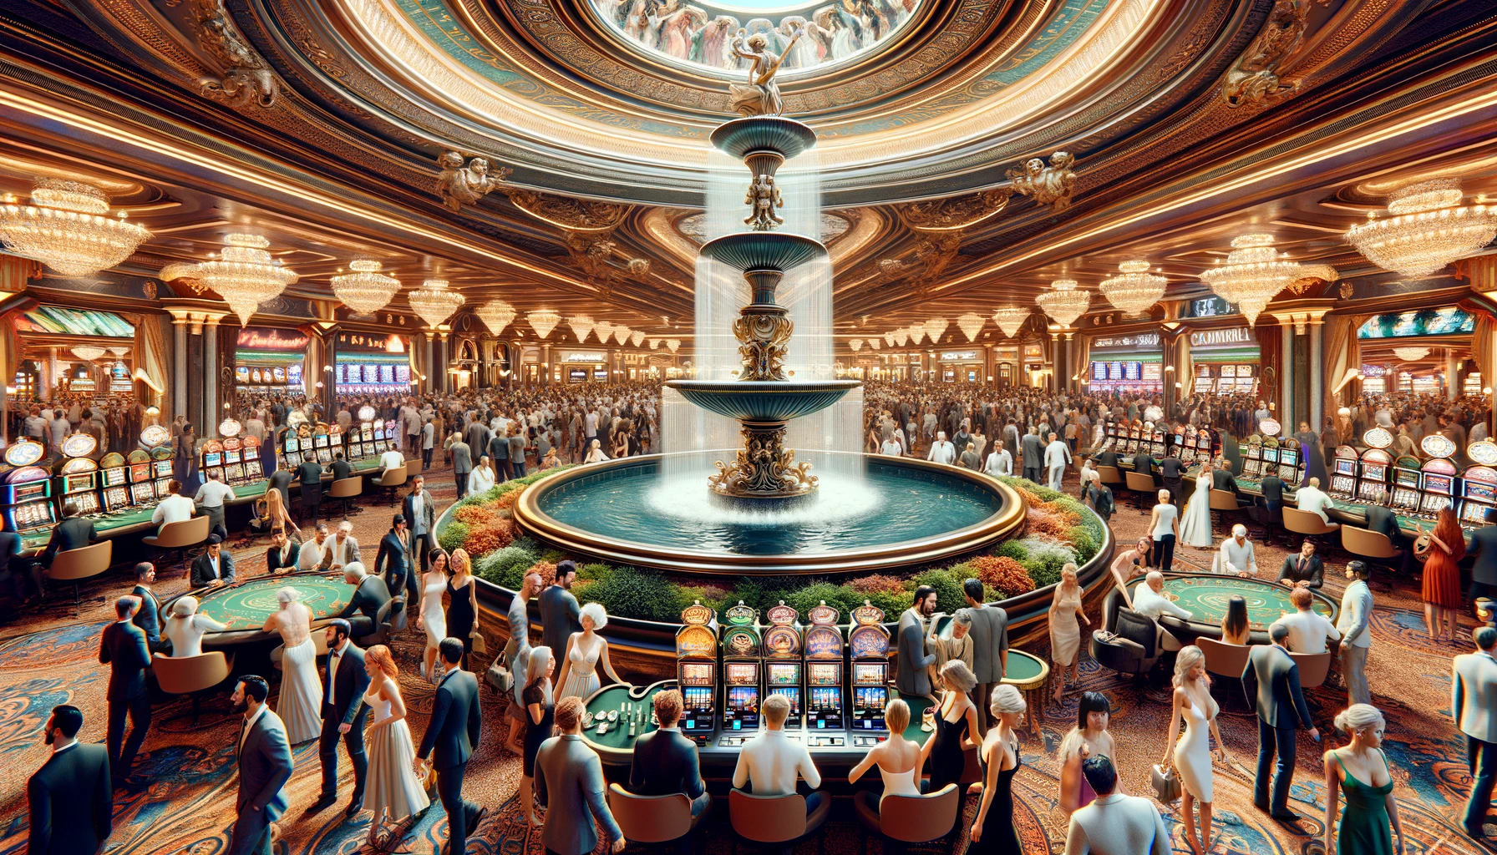
DIGITAL FOUNTAIN CONTROL MODEL
Presenters: Huaiyuan Chu | Dong Yang | Omar Madjitov | (11/28/2023)

Slide 2

AGENDA
INTRODUCTION & MOTIVATION
ABSTRACT MODEL
IMPLEMENTATION & CHALLENGES
DATA COLLECTION
DATA PROCESSING
CONCLUSION

Slide 3
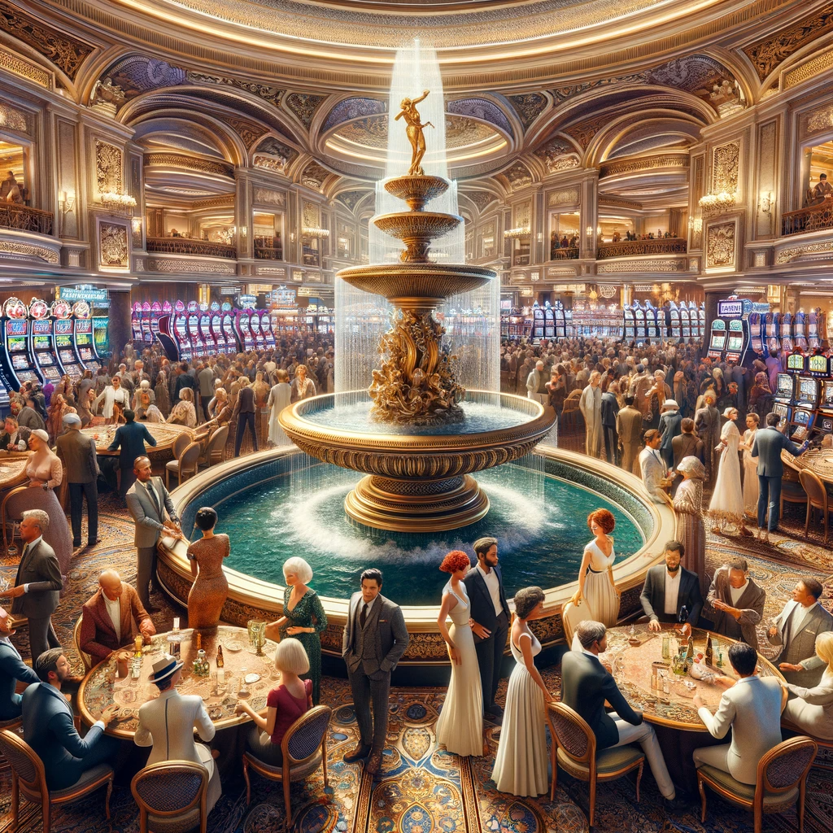
INTRODUCTION
Fountains are often used in Entertainment and Tourism industry(**where there’s a lot of money)
There are several reasons why fountains are appealing to people:
Aesthetic: The synchronized play of water, light, and sound adds beauty and vibrancy to any environment.
Community Engagement: It becomes a focal point for community gatherings, enhancing social interaction.
Therapeutic Effects: The combination of soothing sounds and visual harmony can have a calming effect, contributing to mental well-being.
Cultural Showcase: The fountain can be programmed to reflect local culture and festivities through its music and light shows.

Slide 4
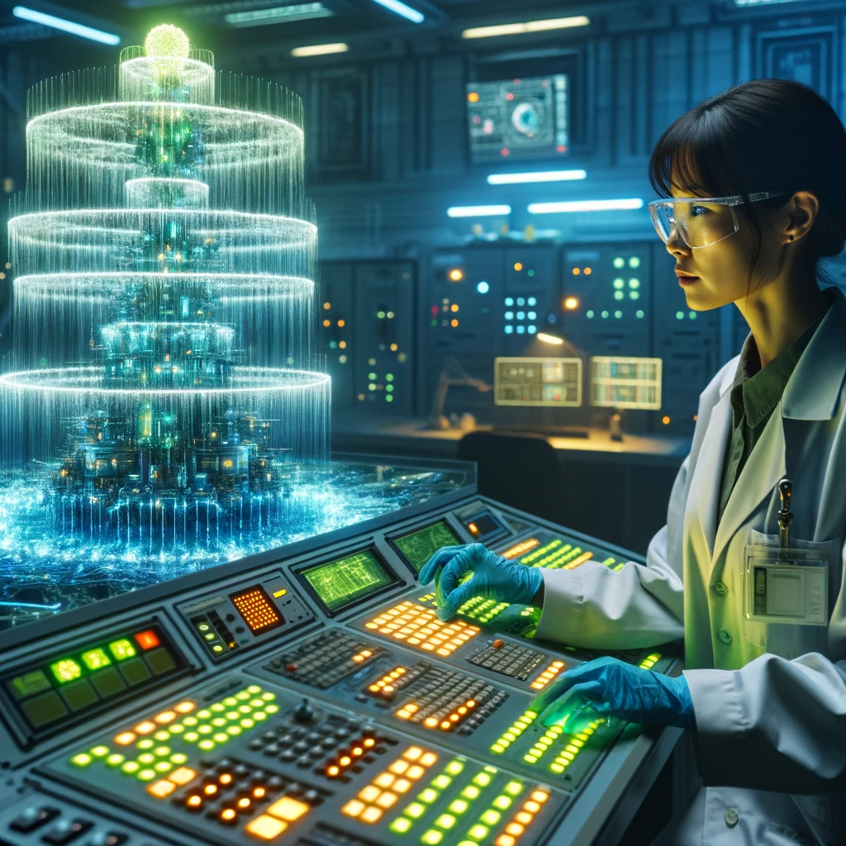
MOTIVATION
CHALLENGES OF MANUAL CONTROL
While this fountain offers numerous benefits, manual control of its features presents several challenges:
Labor Intensive: Constant human oversight for operation and adjustments.
Inconsistency: Human error can lead to irregularities in performance.
Limited Responsiveness: Difficulty in adapting to environmental changes and audience preferences in real-time.
To address these challenges, we propose the development of a smart application.

Slide 5
ABSTRACT MODEL

Slide 6
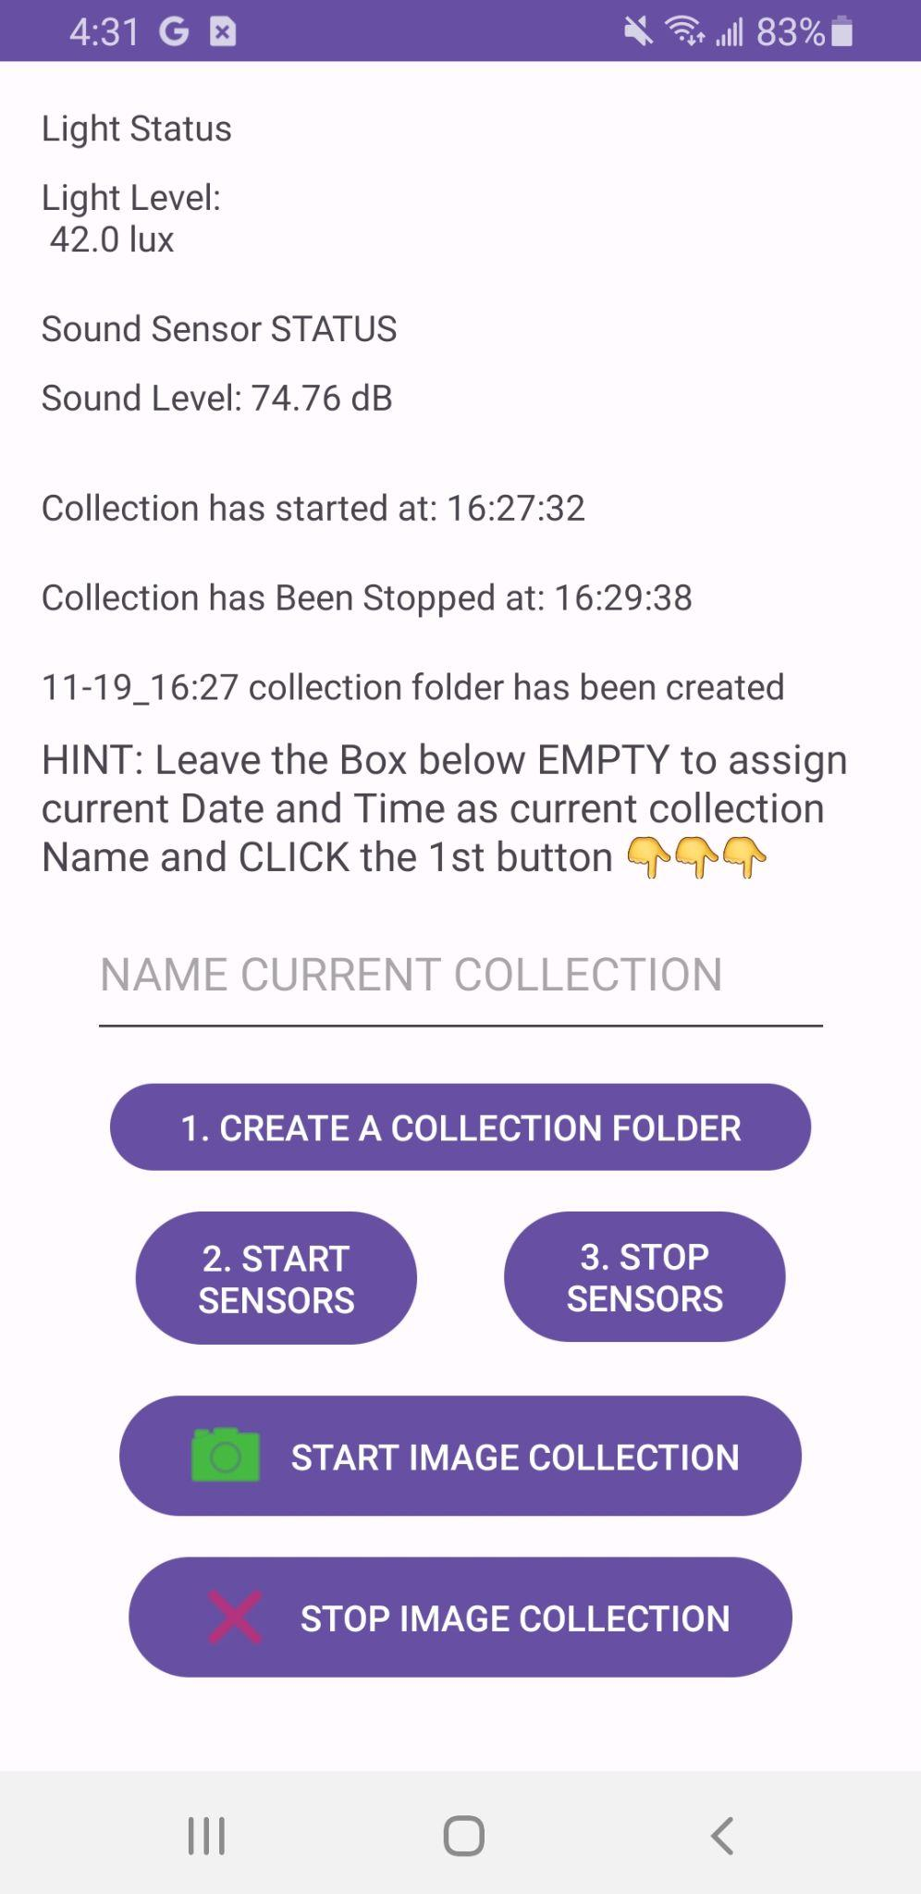
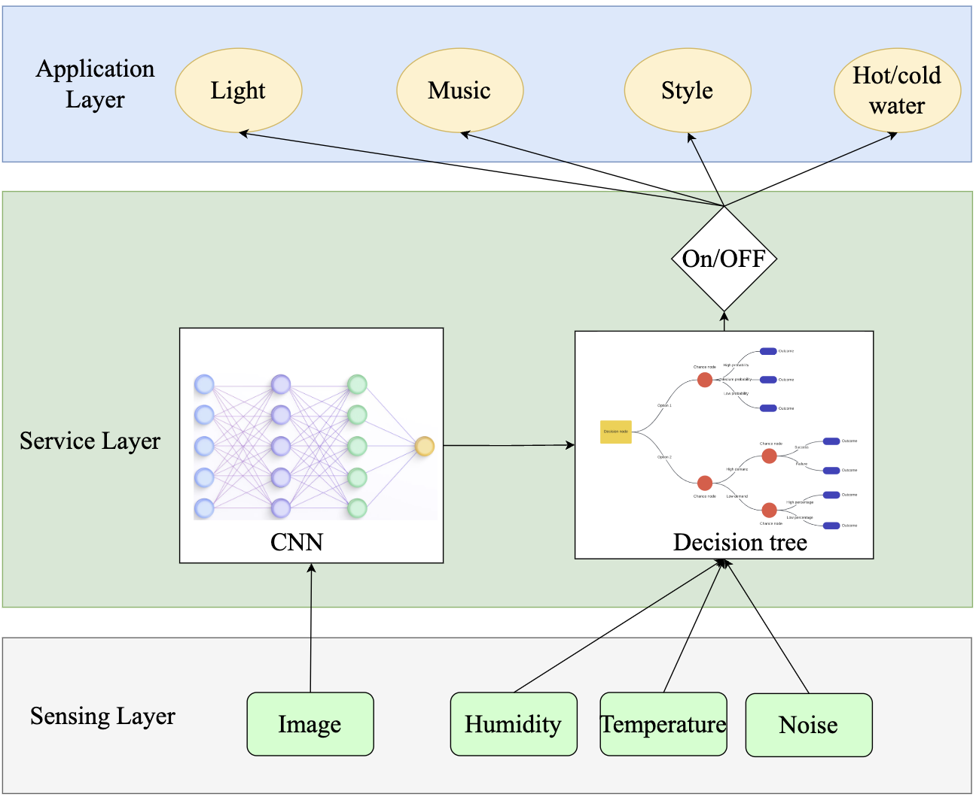
ABSTRACT MODEL
LIGHT
TIME
SOUND

Slide 7

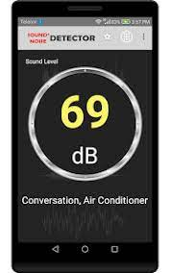
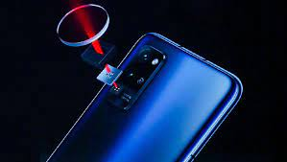
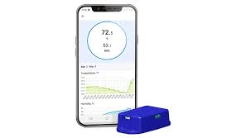
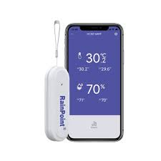
IMPLEMENTATION -- INITIAL PLAN
SENSORS:
LIGHT
SOUND
CAMERA
TEMPERATURE
HUMIDITY

Slide 8
Human Detection
YOLO
YOLO, which stands for "You Only Look Once," is a popular object detection algorithm in computer vision. YOLO is designed to perform real-time object detection by dividing an image into a grid and predicting bounding boxes and class probabilities for objects within each grid cell.
Bayesian Crowd Counting
An approach to estimating the number of people or objects in a crowd using Bayesian methods. This technique leverages Bayesian statistics, which is a framework for updating probabilities based on prior knowledge and new evidence. In the context of crowd counting, Bayesian methods provide a way to model uncertainty and incorporate various sources of information.

Slide 9
Prediction of States
Feature Selection: Carefully consider which light and sound features are most important for determining the fountain, light, and music states.
Creating Dataset: A dataset was created for training decision trees.
Train Decision Tree Model: Train the Model using the training set.
Evaluate Model Performance: Use the test set to assess the model's performance.
Deploy Model: Deploy the model to the actual environment for real-time determination of the fountain, light, and music states.

Slide 10
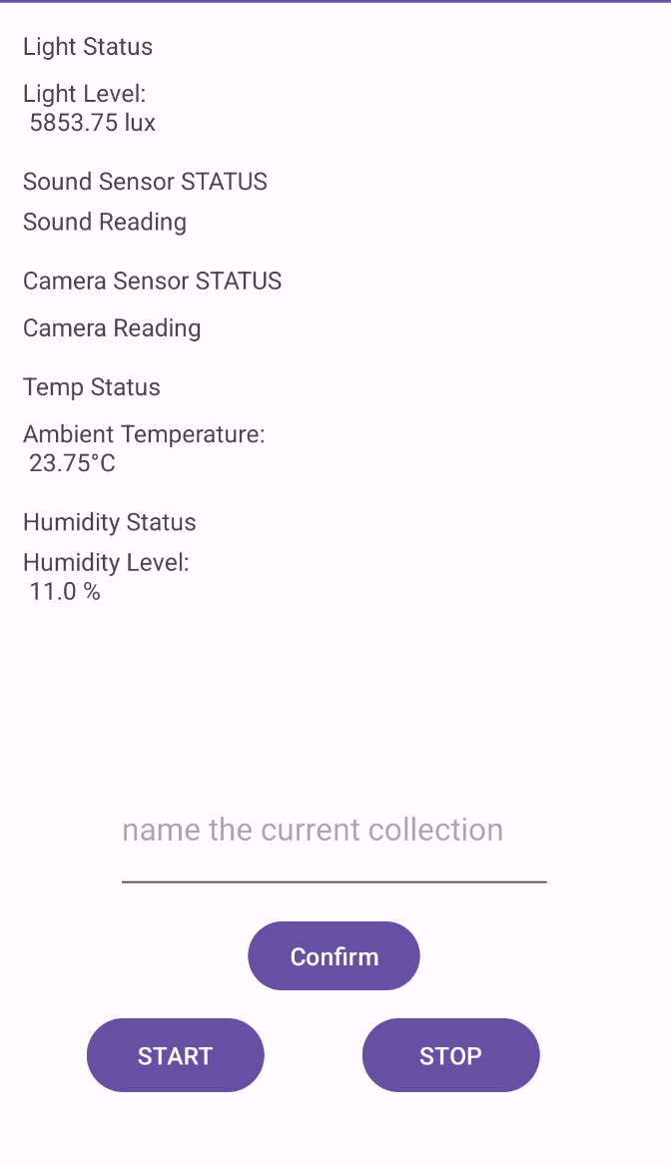
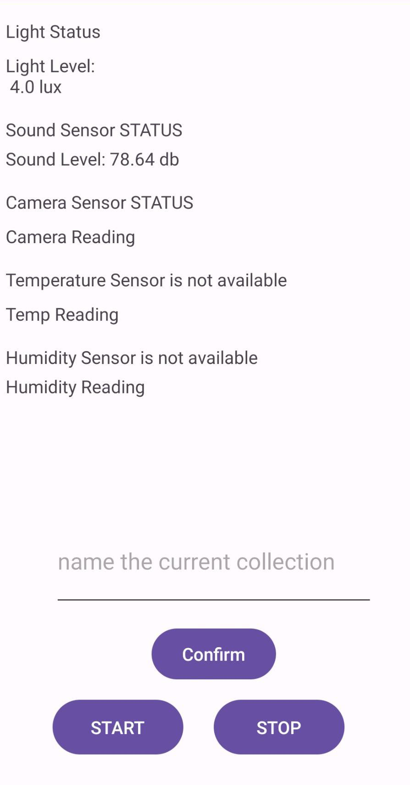
CHALLENGES:
CHALLENGE 1:
Although Virtual Devices do have Humidity and Temperature Sensors, however the Real Hardware Devices don’t have such sensors
VIRTUAL DEVICE
REAL DEVICE

Slide 11
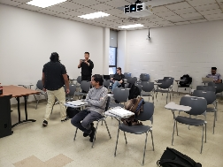
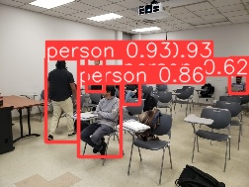
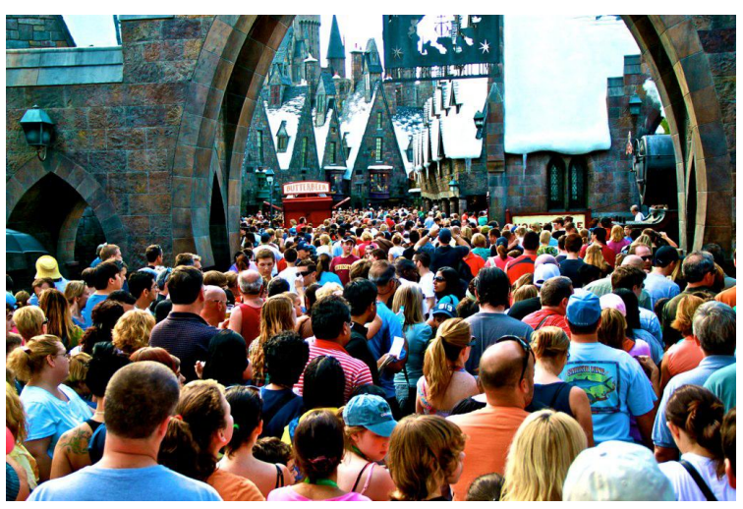
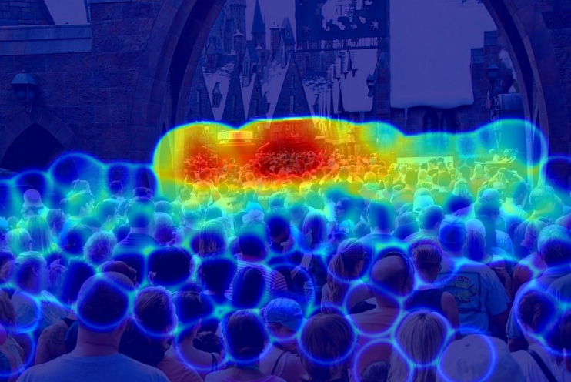
CHALLENGES:
CHALLENGE 2:
Need to compare the output of two models for the same input images for more precise human detection. Yolo is good for a small number and BCC is for a crowd of people.
Get real-time data from Firebase and detect if there is new-coming images.

Slide 12
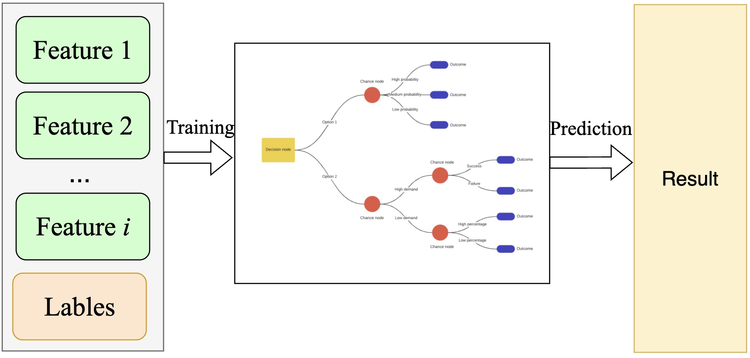
CHALLENGES:
CHALLENGE 3:
The decision tree is an interpretable machine learning model with excellent classification capabilities.
However, this model cannot be used directly. Since it is a supervised model, it requires the creation of a dataset, followed by training before it can be used.

Slide 13

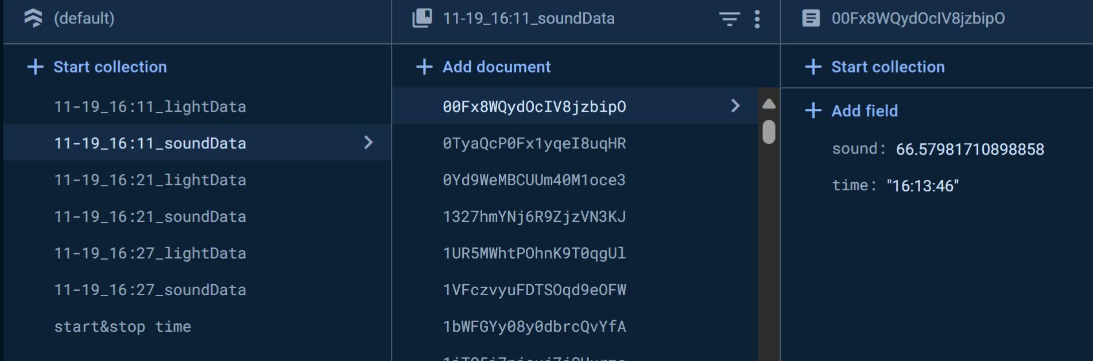
UPDATED MODEL
Collection BEGIN Time →
Collection END Time →
Collection Folder Name →

Slide 14
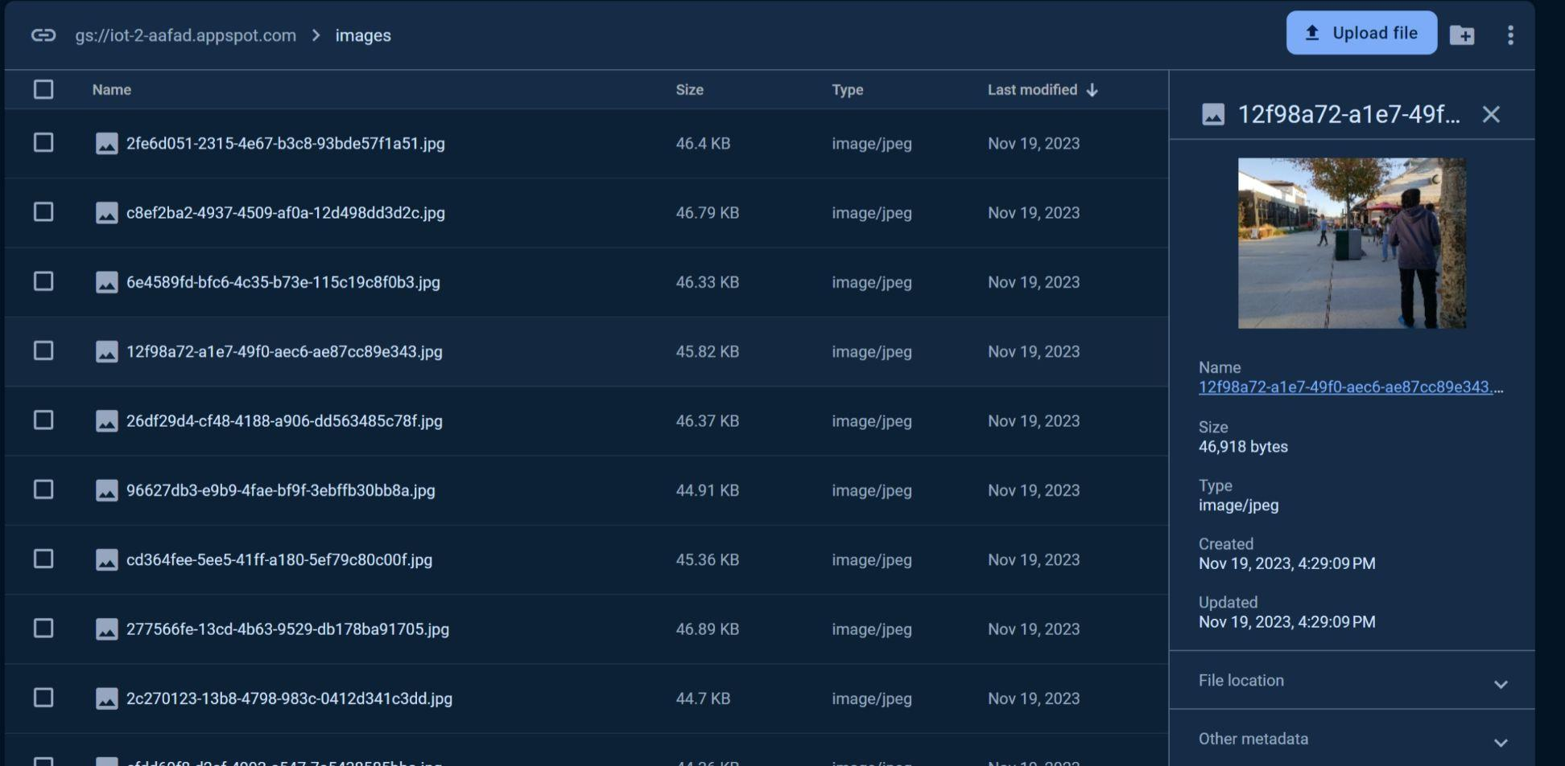
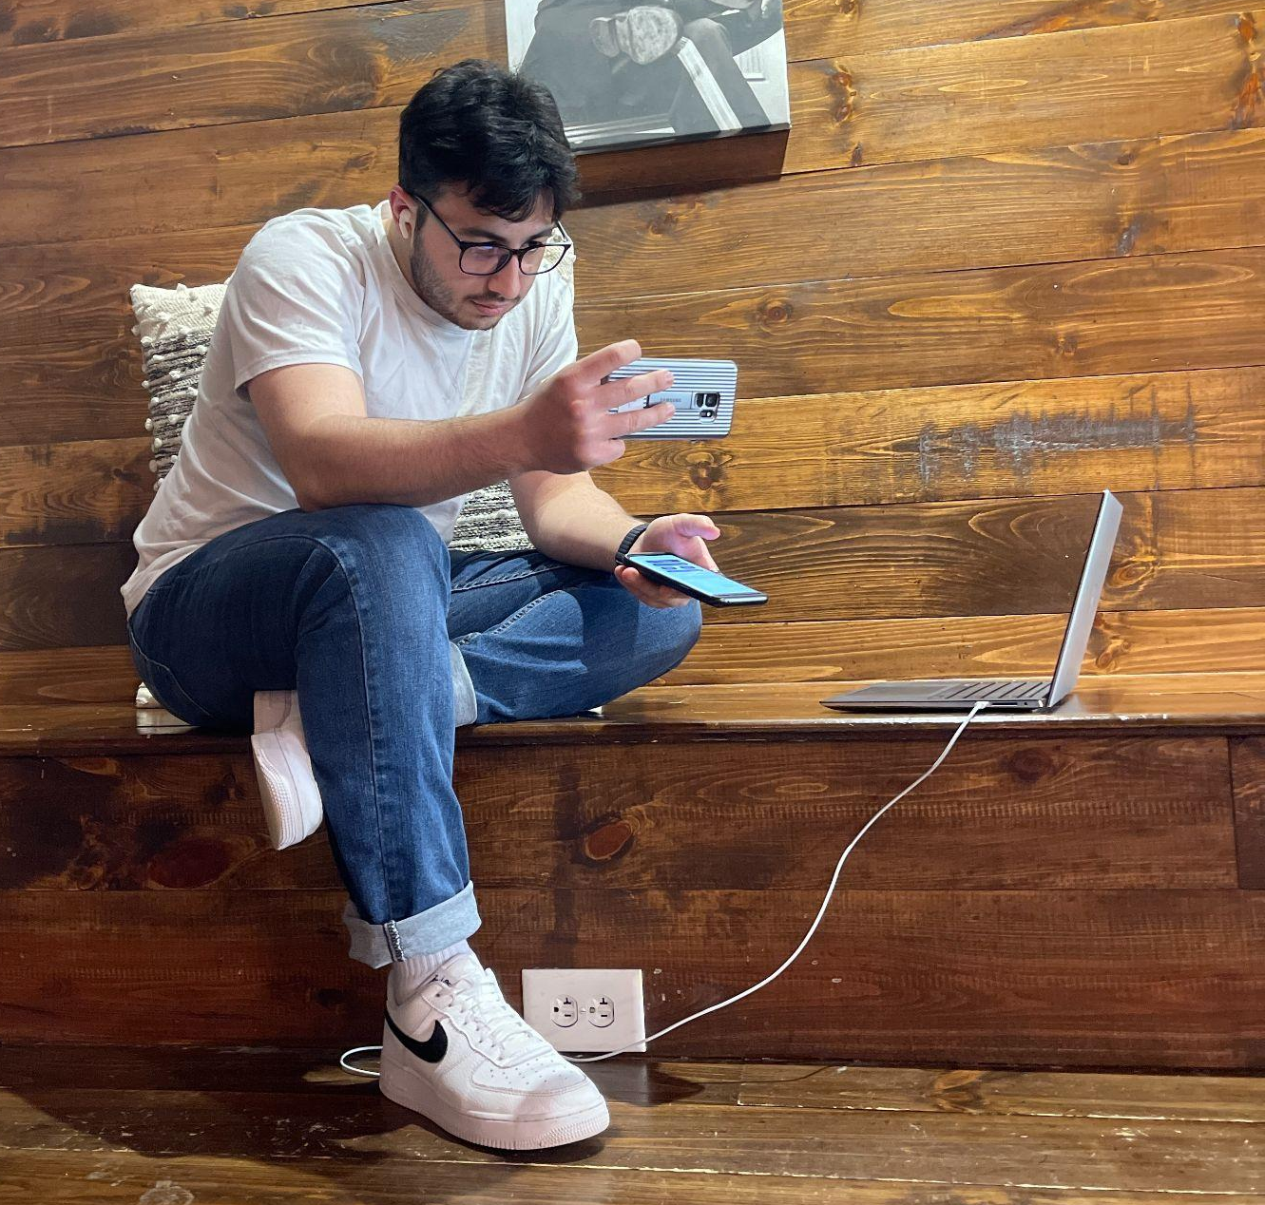
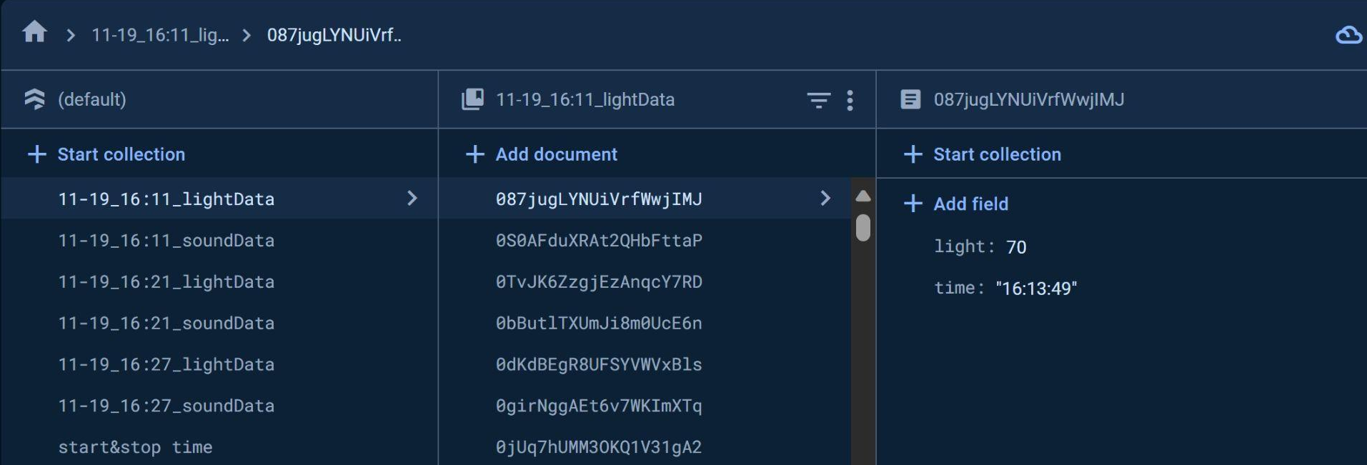
DATA COLLECTION
IMAGE DATA
SOUND DATA
LIGHT DATA

Slide 15
DATA PROCESSING
Compress the images from the phone to a fixed size.
Collect data from Firebase and sort them w.r.t. timestamp.
Low pass filter for all inputs to the decision tree to remove impulsive noise.

Slide 16
DECISION MAKING
Monitor data in Firebase in real time.
Three trained decision tree models to predict the fountain states, fountain light states, and fountain music states respectively.
When the sensor sends data to Firebase, the data is passed to the trained decision tree model, and CNN sends the number of people at that moment to the decision tree.
Predict the fountain states, fountain light states, and music states at this time based on light, sound, and number of people data.

Slide 17
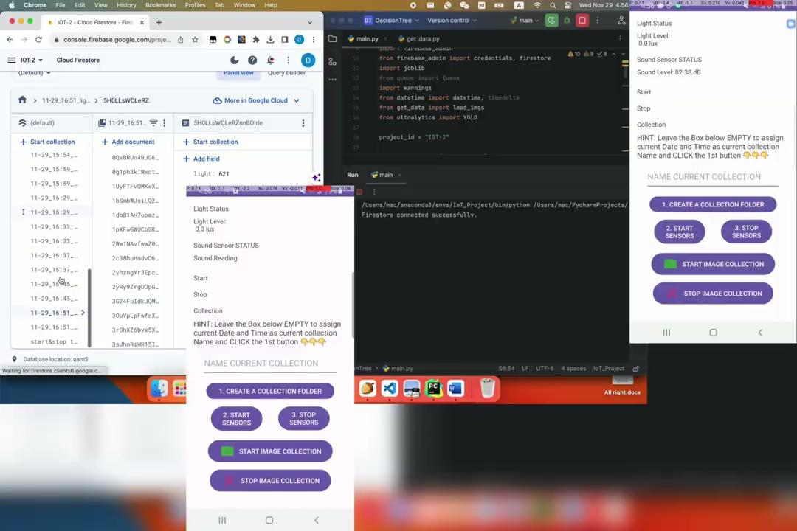

Slide 18
LOGS
image 1/1 /Users/mac/PycharmProjects/DecisionTree/images/2023-11-29 21:56:29.232000+00:00.jpg: 640x480 (no detections), 659.9ms
Speed: 4.0ms preprocess, 659.9ms inference, 10.1ms postprocess per
heads pred is: 0
New data in collection light: 745.0
New data in collection sound: 54.99472631138122
Number of people: 0.0
** Fountain water pressure: ['Close']. Fountain Music Level: ['Close']. Fountain Light Level: ['Close']. **
image 1/1 /Users/mac/PycharmProjects/DecisionTree/images/2023-11-29 21:56:29.389000+00:00.jpg: 640x480 (no detections), 675.4ms
Speed: 1.1ms preprocess, 675.4ms inference, 0.5ms postprocess per
heads pred is: 0
New data in collection light: 746.0
New data in collection sound: 58.15897043224545
Number of people: 0.0
** Fountain water pressure: ['Close']. Fountain Music Level: ['Close']. Fountain Light Level: ['Close']. **
image 1/1 /Users/mac/PycharmProjects/DecisionTree/images/2023-11-29 21:56:34.826000+00:00.jpg: 640x480 (no detections), 596.7ms
Speed: 8.0ms preprocess, 596.7ms inference, 0.6ms postprocess per
heads pred is: 0
New data in collection light: 625.0
New data in collection sound: 47.23455672035186
Number of people: 0.0
** Fountain water pressure: ['Close']. Fountain Music Level: ['Close']. Fountain Light Level: ['Close']. **
image 1/1 /Users/mac/PycharmProjects/DecisionTree/images/2023-11-29 21:56:41.459000+00:00.jpg: 640x480 (no detections), 525.1ms
Speed: 8.4ms preprocess, 525.1ms inference, 0.8ms postprocess per
heads pred is: 0
New data in collection light: 627.0
New data in collection sound: 49.714428529631604
Number of people: 0.0
** Fountain water pressure: ['Close']. Fountain Music Level: ['Close']. Fountain Light Level: ['Close']. **
image 1/1 /Users/mac/PycharmProjects/DecisionTree/images/2023-11-29 21:57:21.587000+00:00.jpg: 640x480 4 persons, 515.2ms
Speed: 6.9ms preprocess, 515.2ms inference, 0.7ms postprocess per
heads pred is: 4
New data in collection light: 424.0
New data in collection sound: 85.73765839653575
Number of people: 4.0
** Fountain water pressure: ['II']. Fountain Music Level: ['II']. Fountain Light Level: ['III']. **
image 1/1 /Users/mac/PycharmProjects/DecisionTree/images/2023-11-29 21:57:29.113000+00:00.jpg: 640x480 3 persons, 572.1ms
Speed: 2.2ms preprocess, 572.1ms inference, 0.9ms postprocess per
heads pred is: 3
New data in collection light: 609.0
New data in collection sound: 50.13010064809744
Number of people: 3.0
** Fountain water pressure: ['II']. Fountain Music Level: ['II']. Fountain Light Level: ['II']. **
image 1/1 /Users/mac/PycharmProjects/DecisionTree/images/2023-11-29 21:57:38.530000+00:00.jpg: 640x480 3 persons, 503.7ms
Speed: 3.2ms preprocess, 503.7ms inference, 0.6ms postprocess per
heads pred is: 3
New data in collection light: 901.0
New data in collection sound: 43.52182518111363
Number of people: 3.0
** Fountain water pressure: ['II']. Fountain Music Level: ['I']. Fountain Light Level: ['I']. **
image 1/1 /Users/mac/PycharmProjects/DecisionTree/images/2023-11-29 21:57:44.673000+00:00.jpg: 640x480 (no detections), 565.1ms
Speed: 7.0ms preprocess, 565.1ms inference, 0.5ms postprocess per
heads pred is: 0
New data in collection light: 892.0
New data in collection sound: 70.62191093740056
Number of people: 0.0
** Fountain water pressure: ['Close']. Fountain Music Level: ['Close']. Fountain Light Level: ['Close']. **
User interrupted program execution
image 1/1 /Users/mac/PycharmProjects/DecisionTree/images/2023-11-29 21:56:50.750000+00:00.jpg: 640x480 1 person, 771.7ms
Speed: 5.0ms preprocess, 771.7ms inference, 7.1ms postprocess per
heads pred is: 1
New data in collection light: 629.0
New data in collection sound: 65.06191171698063
Number of people: 1.0
** Fountain water pressure: ['I']. Fountain Music Level: ['II']. Fountain Light Level: ['II']. **
image 1/1 /Users/mac/PycharmProjects/DecisionTree/images/2023-11-29 21:56:57.672000+00:00.jpg: 640x480 2 persons, 536.4ms
Speed: 2.9ms preprocess, 536.4ms inference, 0.6ms postprocess per
heads pred is: 2
New data in collection light: 595.0
New data in collection sound: 44.810984965652
Number of people: 2.0
** Fountain water pressure: ['II']. Fountain Music Level: ['II']. Fountain Light Level: ['I']. **
image 1/1 /Users/mac/PycharmProjects/DecisionTree/images/2023-11-29 21:57:06.201000+00:00.jpg: 640x480 2 persons, 518.8ms
Speed: 7.7ms preprocess, 518.8ms inference, 0.6ms postprocess per
heads pred is: 2
New data in collection light: 297.0
New data in collection sound: 44.910253356283
Number of people: 2.0
** Fountain water pressure: ['II']. Fountain Music Level: ['III']. Fountain Light Level: ['I']. **
image 1/1 /Users/mac/PycharmProjects/DecisionTree/images/2023-11-29 21:57:14.162000+00:00.jpg: 640x480 3 persons, 512.4ms
Speed: 4.4ms preprocess, 512.4ms inference, 0.6ms postprocess per
heads pred is: 3
New data in collection light: 455.0
New data in collection sound: 81.2801697306345
Number of people: 3.0
** Fountain water pressure: ['II']. Fountain Music Level: ['II']. Fountain Light Level: ['III']. **

Slide 19

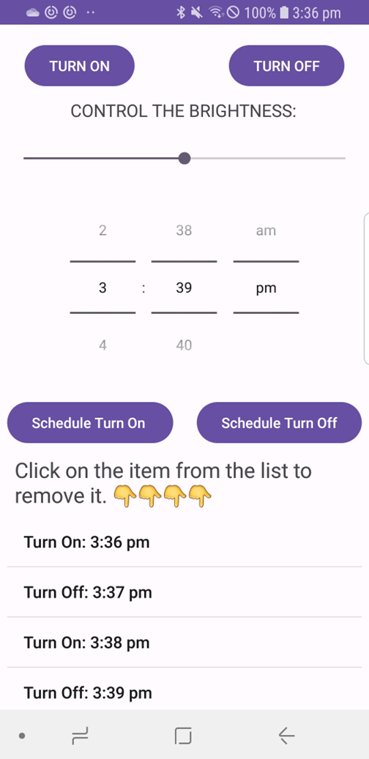
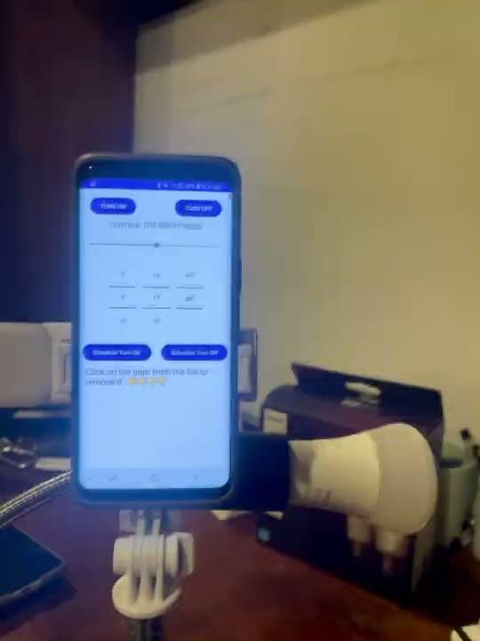
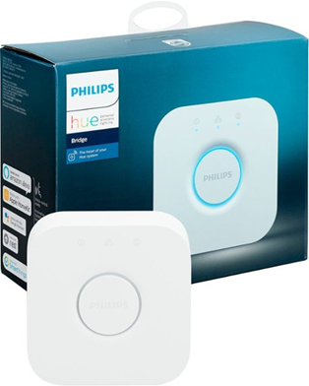
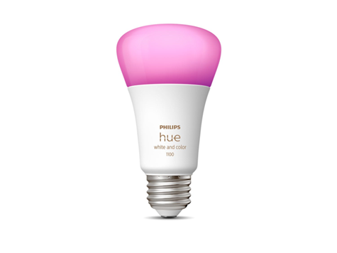
LIGHT CONTROL DEMO

Slide 20
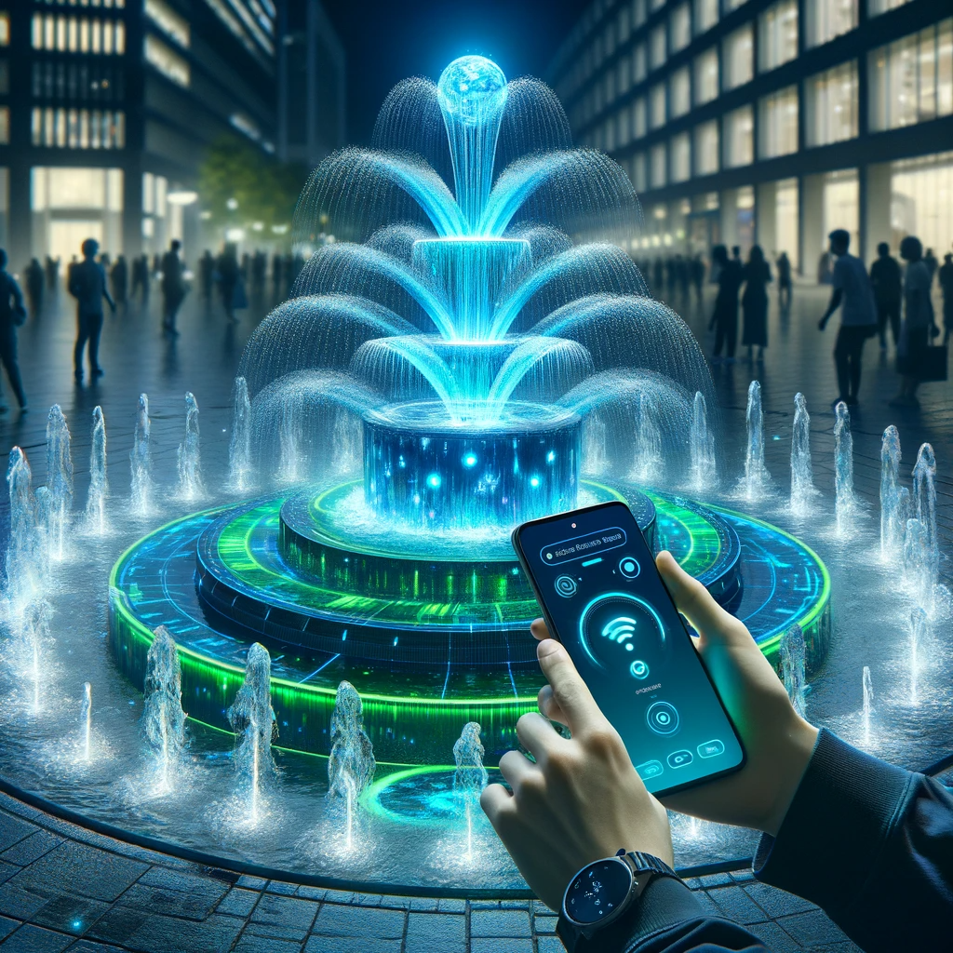
Conclusion
As a team we were able to Implement the project where we collect phone sensor data and push it to a cloud. Then use deep learning models to implement head counting on images uploaded to Firebase, and combine it with Light & Sound data as the input to Decision Tree to get the final instruction to control the real devices, e.g. fountain and lights.

Slide 21

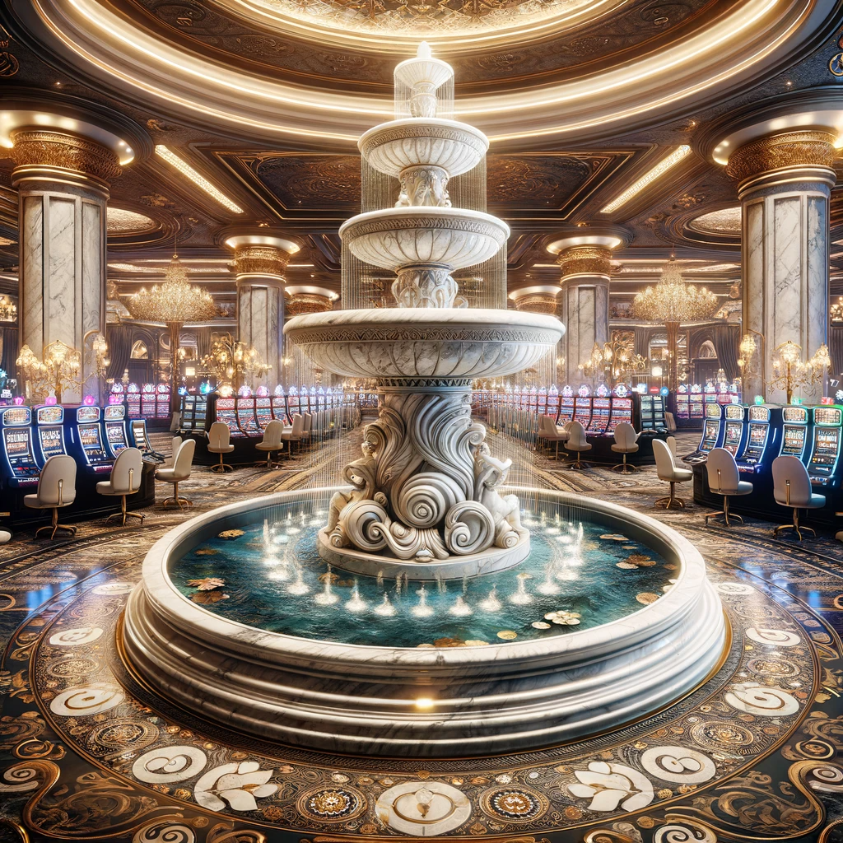
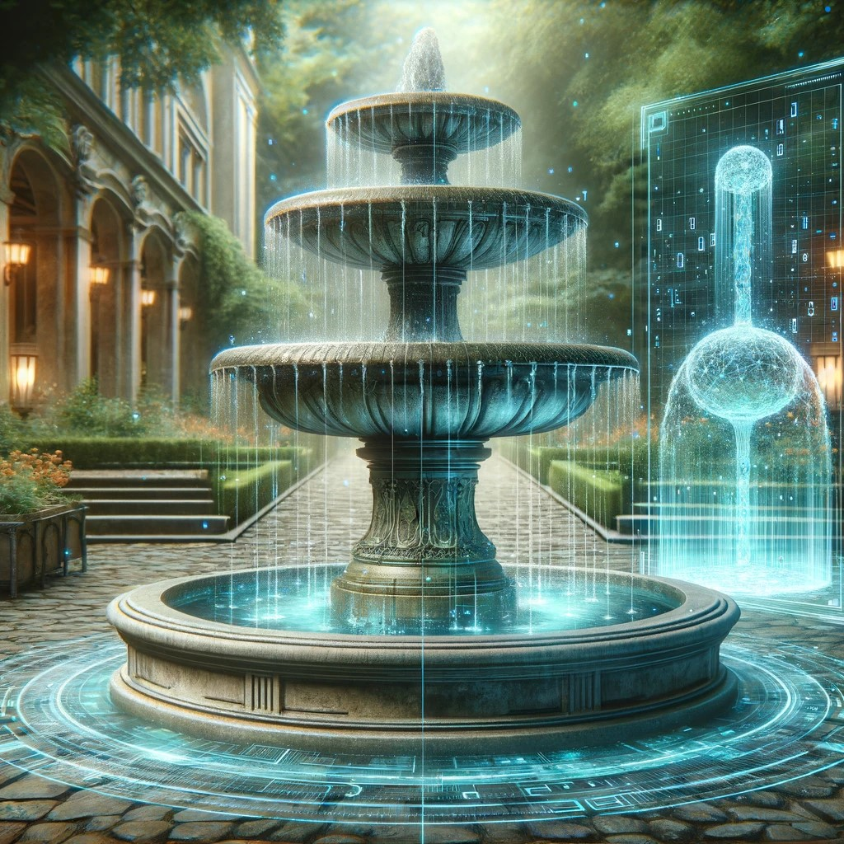

THANK YOU
Huaiyuan Chu
————————
Dong Yang
————————
Omar Madjitov

